Slide 1
Linear Equations in x

Slide 2
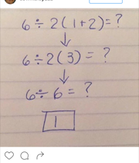
DO NOW:
Do you agree with the work in this picture? If yes, why? If no, why?

Slide 3
We need to define…
“linear equation in x”
Here are some examples of linear equations in x. Take a few minutes to come up with your definition of the phrase.

Slide 4
A linear equation in x….
Is a statement about _____________.
It is also an invitation to find all of the numbers of _____.

Slide 5
Example 1:
4 + 15x = 49
Is there a number, x, that makes this true? Suppose x = 2.

Slide 6
Example 1:
4 + 15x = 49
Is the number 3 a solution to the equation?

Slide 7
Example 2:
8x – 19 = -4 – 7x
Is 5 a solution to the equation?

Slide 8
Example 2:
8x – 19 = -4 – 7x
Is 1 a solution to the equation?

Slide 9

Example 3:
3(x + 9) = 4x – 7 + 7x
Is $\frac{5}{4}$ a solution to the equation?

Slide 10
Example 4:
-2x + 11 – 5x = 5 – 6x
Is 6 a solution to the equation?

