Slide 1
DO NOW
Make 24 with the following numbers using + - * and ÷ :
8 2 5 6

Slide 2
Linear Equations in Disguise

Slide 3

Theorem:
Given ______________ numbers A, B, C, and D, so that B ____ and
D ____ the property states the following:
$$\frac{x}{5}=\frac{6}{12}$$

Slide 4
Example 1:
$$\frac{x−1}{2}=\frac{x+\frac{1}{3}}{12}$$

Slide 5
Example 2:
$$\frac{\frac{1}{5}−x}{7}=\frac{2x+9}{3}$$

Slide 6
Example 3:
$$\frac{6+x}{7x+\frac{2}{3}}=\frac{3}{8}$$

Slide 7
Example 4:
$$\frac{7}{3x+9}=\frac{1}{8}$$

Slide 8
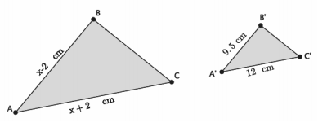
Example 5:

